Slide 1
Recruiting
Best Practices

Slide 2
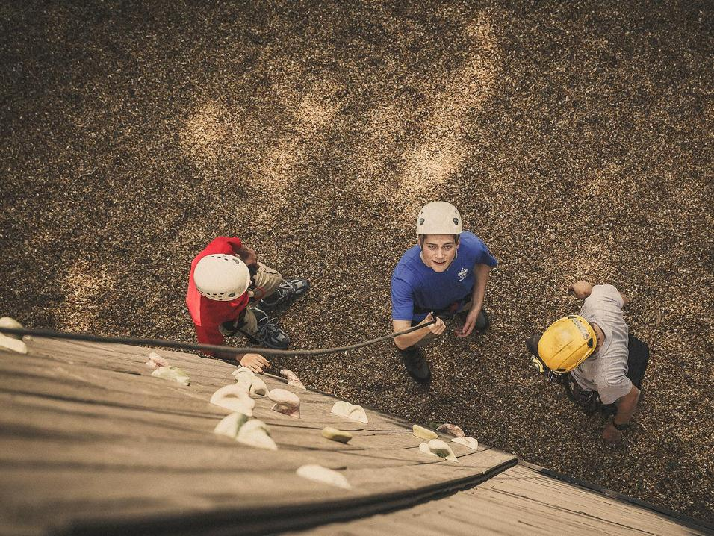
Why do recruitment?

Slide 3
1st Law of Motion
an object either remains at rest or continues to move at a constant velocity, unless acted upon by a force

Slide 4
1st Law of Motion
Either we recruit new scouts or the number of scouts in our program will continue to drop.

Slide 5
1st Law of Motion
Either we recruit new scouts or the number of scouts in our program will continue to drop.

Slide 6
Why is recruiting necessary?
Grow unit membership
Replenish unit membership
Foster excitement among Scouting-age boys (and girls!)
Promote Scouting in the community

Slide 7
SCOUT JOINING FUNNEL
Top of Mind awareness
Groups / Bloggers
Digital Media Ads
Brand Perception
Nurture
Paid Search Ads (Google & Bing)
Family Is/Was a Scout
BeAScout Lead Activation
Word of Mouth (Marketing)
Sell
Presentations at School
Adventures Fliers
School Nights
JOIN
Social Channels
Retention
ScoutingWire
Email Outreach
ADVOCATE
Local Touchpoints
Magazines

Slide 8
Top of Mind Awareness
Top-of-mind awareness (TOMA) refers to a brand or specific product being first in customers' minds when thinking of a particular industry or category

Slide 9
Brand Perception
Brand Perception refers to the extent to which customers are able to recall or recognize a brand and their association and perception of such.
The consumer's ability to recognize or recall a brand is central to purchasing decision-making.

Slide 10
Word of Mouth
Word-of-mouth marketing, differs from naturally occurring word of mouth, in that it is actively influenced or encouraged by organizations (e.g. 'seeding' a message in a networks)

Slide 11
Recruitment

Slide 12
Who to recruit for a pack?
Scouting-age boys and/or girls, obviously!
The Lion program is now official nationwide, so packs can recruit kindergarten-age boys and/or girls.
But remember that, especially with respect to younger potential Cub Scouts, you are also trying to “recruit” their parents
Try to use recruiting efforts and activities that will get boys/girls interested and excited, but that also engage parents and get them thinking about the Scouting program and what it has to offer

Slide 13
Who to recruit for a troop?
Scouting-age boys or girls, obviously!
The Scouts BSA program is now official nationwide for boys or girls.
Try to use recruiting efforts and activities that will get boys or girls interested and excited, will serve as an example of what to expect
Scout lead recruiting, parents will usually will not signup unless needed.

Slide 14
When to recruit for Cub Scouts?
Fall: August/September (with follow-up in October and November)
Fall is traditional recruitment season
Usually corresponds with the beginning of the school year and the beginning of the Scouting year (i.e., when meetings begin again after summer)
Spring: March/April (with follow-up in May and June)
Although not the “typical” time to recruit, units should also try to do spring recruiting to supplement their membership recruitment efforts
Spring recruiting corresponds with post-AOL cross-over
If a pack is going to have summertime activities (and all packs should), new youth who join in the spring will have fun activities. They can also attend summer camp and/or the weekly “Family Nights” at summer camp.

Slide 15
When to recruit for Scouts BSA?
Winter: December/February
Winter is the recruitment season for Scouts BSA non-cub recruitment time.
Not many activities going on and parents are looking for something
Good time to meet incoming pack leadership
Plan joint activities as weather permitting
Prepare for AOL Cross-over
Spring: February/April
The typical time to recruit
Spring recruiting corresponds with AOL cross-over
Summer camp is an important event and your new scouts should meet you

Slide 16
When to recruit?
ALWAYS!
Every den, pack or troop meeting is a recruitment opportunity.
Your Scouts should be encouraged to invite their friends at any time.
Promoting your unit year-round (see our Social Media for Recruiting module) opens the door to year-round recruiting.

Slide 17
How to recruit?
Plan
The event should be something that is FUN – fishing, rockets, STEM, etc. (Council has resources you can use!)
Line up the venue and volunteers
Advertise
Flyers and Lawn Signs (available for FREE from Council!)
Digital media/Social media
Community events (e.g., Back to School Nights, Kindergarten Orientation/Sign Up, Town Carnivals/Fairs, etc.)
Communicate through as many channels as possible!

Slide 18
How to recruit?
Execute
Provide contact information for den leaders or other adult volunteers as appropriate
Have the calendar of events available so that prospective boys and girls and their parents can see the program and what to look forward to
Make sure you have enough manpower to run the activity, collect application forms, and take parents aside to explain the benefits of Scouting
Make sure you have application forms and your committee has decided how much to collect.
A credit card reader can help get people signed up right away. Borrow one from the council.

Slide 19
How to recruit?
Execute
Provide contact information for den leaders or other adult volunteers as appropriate
Have the calendar of events available so that prospective boys and girls and their parents can see the program and what to look forward to
Make sure you have enough manpower to run the activity, collect application forms, and take parents aside to explain the benefits of Scouting
Make sure you have application forms and your committee has decided how much to collect.
A credit card reader can help get people signed up right away. Borrow one from the council.

Slide 20
How to recruit?
Execute
Emphasize the “why” of Scouting. We are more than a fun program. We develop character, leadership, resiliency, friendships. We are a better than choice than the many other programs seeking their participation.
Our Adventures in Cub Scouting & Adventures in Scouts BSA booklets help explain the “why”.
A New Member Coordinator in distinctive red polo will help new parents connect.
Have people sign in as they arrive. This will help with follow up. Using a laptop will free you from deciphering handwriting (but have someone hit “save” periodically).

Slide 21
How to recruit?
Follow-up
Plan a fun event a few weeks after the Open House/Recruiting Event
New Member Coordinator follows up with parents after the event using the sign-in list.
New Member Coordinator follows up with families who have joined to make sure they have connected with their den leader and are attending.

Slide 22
Charter Organization Relation

Slide 23
Be Active
Frequency
Participate in events
Talk to your Charter Org Rep
Visit the organization often
Do not just visit when you need something
Be Seen
Reach
Make sure you wear your uniform
Talk to members
Go to several events, not just popular
Talk to different people
Engage
Consistency
Talk to members and get to know them
Community service
Make a schedule for visits
Do not visit once a year

Slide 24
Scout Visibility

Slide 25
Town Activities
Fairs
School events

Slide 26
Community Service
In Town activity

Slide 27
Be active
Be seen
Engage

Slide 28
Pack-Troop Relation

Slide 29
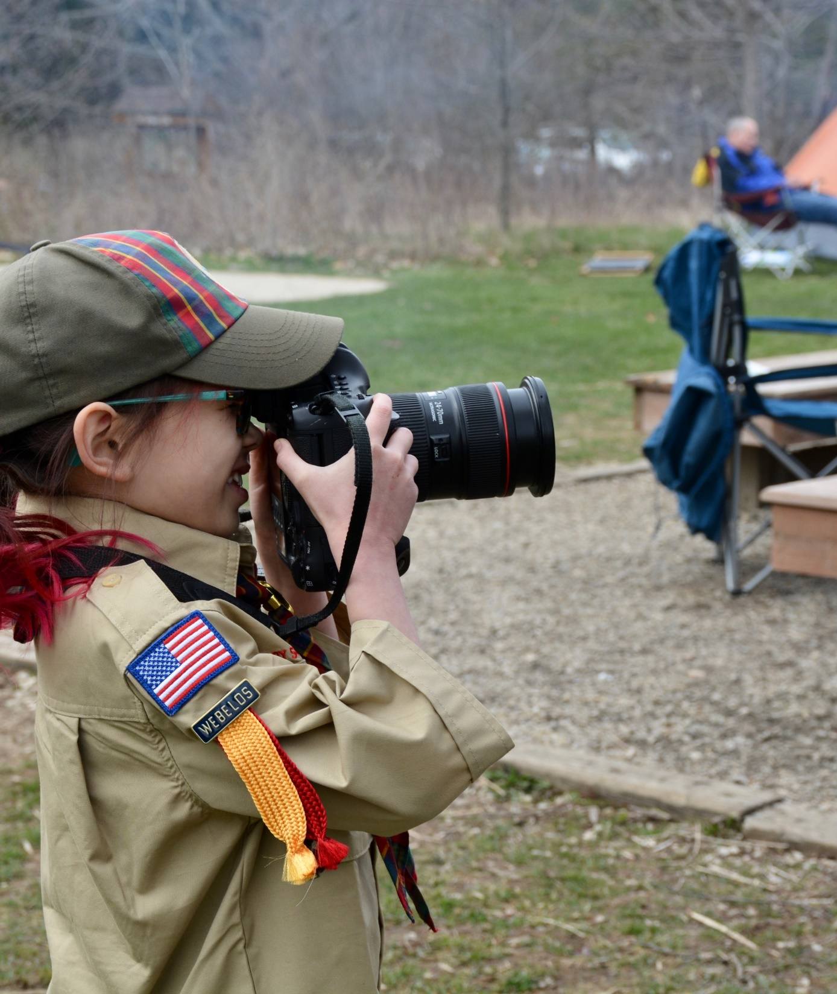
Avoid Feeder Packs
Den Chief
Troop Activities
Blue and Gold
District Events

Slide 30
Recruiting Parents while Recruiting Youth
Some units avoid asking new parents to volunteer right away. That is fine if you have an abundance of leaders.
Most units need some new leaders asap. Den leaders for new dens?
Rather than asking for one or two leaders, some units tell all new parents that they will each help out somehow.
“We are all in this together.” “A good pack is fun for your child. A great pack will influence them for life. The difference between good and great is everybody helping out”.

Slide 31
Recruiting Parents while Recruiting Youth
It may be easier for two parents to agree to run a den together knowing that they have support from each other.
Some units have a list of tasks and ask parents to choose how they can help.
Invite all parents to your next committee meeting. Calling it a “parent meeting” may be more attractive. Let them know the meeting will be brief and at least partly about socializing with new friends.

Slide 32
Web (Parent to Parent)
Websites
BeAScout.org
TapInto

Slide 33
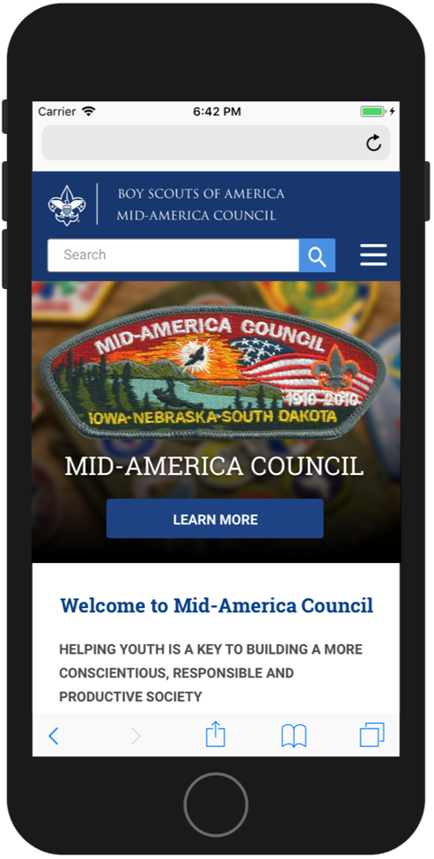
Social Media (Youth to Youth)
Facebook
Instagram
New Apps

Slide 34
Summary

Slide 35
There is no magic formula!
Youth to Youth Recruitment
Parents snapshot
Personalize it
UNIFORMS
Key Clubs
Scouting is Fun!

Slide 36
Resources
Scoutingwire.org
PPCBSA.org
Scouting.webdamdb.com/bp/#/
Facebook Groups
Javier Juarez
973.765.9322x257
Javier.Juarez@scouting.org

Slide 37
Ultimately, the best recruiting tool you have available is putting on a good program!

Slide 38
Questions?

