Slide 1
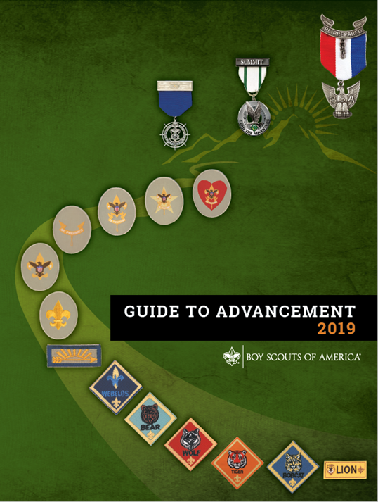
2019 Guide to Advancement
Michael Merritt
Patriots’ Path Council Advancement Committee
Member-at-Large for Events
michael@mischu.me
973 568 7979
Karen Gough
Raritan Valley District
Advancement Committee Chair
nj.goughs@gmail.com
University of Scouting
December 5, 2020
The Source for Advancement Issues

Slide 2
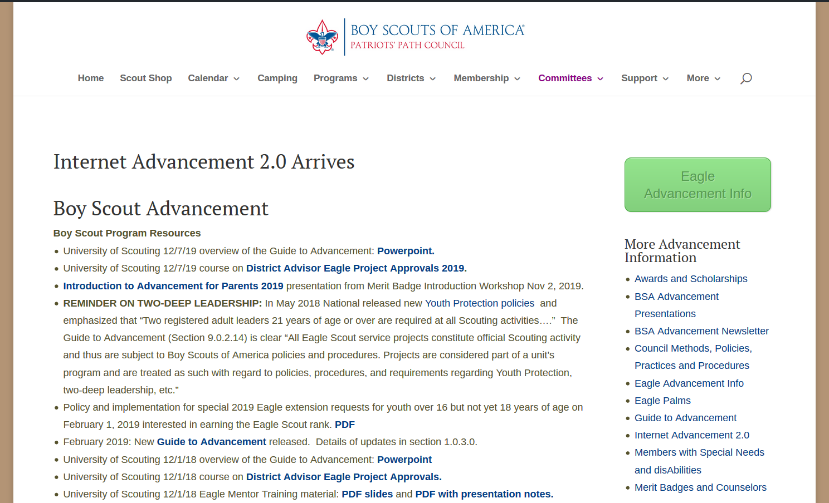
Notes:
This presentation can be found in the PPC Advancement Committee webpage.

Slide 3
2019 Guide to Advancement
BSA Mission Statement
The mission of the Boy Scouts of America is to prepare young people to make ethical and moral choices over their lifetimes by instilling in them the values of the Scout Oath and Scout Law.
The Aims of Scouting
Every Scouting activity moves young people toward the basic aims of: character development, citizenship training, leadership, and mental and physical fitness.
Advancement is one of the eight methods used by Scout leaders to help youth fulfill the aims of the BSA.
Notes:
The Guide to Advancement has undergone extensive revision to ensure it supports the mission and aims of scouting.

Slide 4
Council Advancement Committee
RESPONSIBILITIES
The council advancement committee and the 6 district advancement committees are responsible for implementing and facilitating advancement and processing most special awards and recognitions. This is done according to national procedures and local practices under the direction of the council executive board. The council advancement committee falls under the vice president for program.
Notes:
This presentation starts local and works up…the GTA delegates decisions and implementation to Council and District advancement committees.

Slide 5
Council Advancement Committee
APPROACH
We follow BSA’s official source for administering advancement, the Guide to Advancement.
For situations not specifically covered in that document, we make decisions based on the aims and mission of the Boy Scouts of America, the Scout Oath and Scout Law, and common sense.
Advancement is nothing more and nothing less than a method. It is a means toward accomplishing the Boy Scouts of America mission; not an end in itself.

Slide 6
Council Advancement Committee
WHO IS THE COMMITTEE?
  Chair,
  Chairs of the 6 district advancement committees,
  Members-at-large.
We cooperate with the other program function elements—outdoor programs, activities and civic service, and training—and also with the membership, finance, and unit-service functions. The committee is supported by a council professional staff advisor.
Notes:
These volunteers represent a breadth of experience, both in Scouting and professionally.

Slide 7
Council Advancement Committee
Chairman Bruce Benson
Vice Chairman George Kamper
Members at Large Scott Berger New Merit Badges
Mary Lynne Capen Member at Large
Deb Reidmiller Special Needs
Martha Kamichoff Camp Advancement
Michael Merritt Events
District Chairs Dave Meehan Black River
Bob Weber Fishawack
Peter Glaser Munsee
Deb Hopkins Raritan Valley
George Lippencott Sussex
Christine O’Brien Watchung Mountain
Council Advisor Al Thomas Patriots’ Path Council
https://ppcbsa.org/committees/advancement/

Slide 8
Local Council Policies
Community Service Reporting for Eagle Scout Service Projects
Council Advancement Committee Membership and Meetings
Council Policy and Procedure on Limited Exceptions to Swimming Requirements
Eagle Scout paperwork for Council and Boards of Review
Eagle Scout Service Project Funding Policy
Merit Badge Counselor Policy
Methods for Conducting Eagle Scout Boards of Review
https://ppcbsa.org/committees/advancement/council-methods-policies-practices-and-procedures/

Slide 9

2019 Guide to Advancement
Where can I get the 2019 GTA?
Online version
www.scouting.org/filestore/pdf/33088.pdf

Slide 10
2019 Guide to Advancement

Slide 11
2019 Guide to Advancement

Slide 12


2019 Guide to Advancement

Slide 13
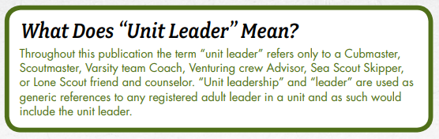
2019 Guide to Advancement
Throughout this publication the term “unit leader” refers only to a Cubmaster, Scoutmaster, Venturing crew Advisor, Sea Scout Skipper, or Lone Scout friend and counselor. “Unit leadership” and “leader” are used as generic references to any registered adult leader in a unit and as such would include the unit leader.

Slide 14
CONTENTS
Section 1 Introduction
Section 2 Advancement Defined
Section 3 Guidelines for Advancement and Recognition Committees
Section 4 The Mechanics of Advancement
Section 5 Special Considerations
Section 6 Electronic Advancement Reporting
Section 7 The Merit Badge Program
Section 8 Boards of Review: An Overview for All Ranks
Section 9 The Eagle Scout Rank
Section 10 Advancement for Members with
Special Needs
Section 11 Appendix

Slide 15
Section 1 Introduction
The current edition of the Guide to Advancement is the official source for administering advancement in all Boy Scouts of America programs: Cub Scouting, Scouts BSA, Venturing, and Sea Scouts. It replaces any previous BSA advancement manuals and previous editions of the Guide to Advancement.
Producing the Guide to Advancement has involved many members of the Boy Scouts of America’s national staff and many volunteer advancement administrators and subject matter experts at all levels from across the country. The result is an improved resource intended to more efficiently meet the needs of those who would most often consult it. Additional information and best practices appear in other official BSA resources such as Advancement News, the National Advancement Program Team’s Twitter feed, and the advancement educational presentations released by the National Advancement Program Team.
See “Orientation and Education Opportunities for Advancement Administrators,” 3.0.0.6, for more information on education in advancement policies and procedures. Scouting leaders are encouraged to make full use of these resources but should confirm that updated information has not subsequently been provided.

Slide 16
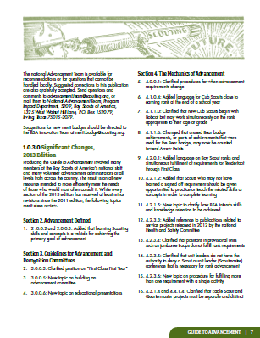
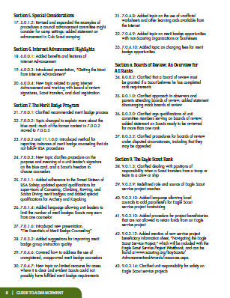
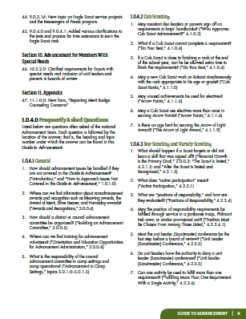
Section 1 Introduction
1.0.3.0 Significant Changes
While every section of this guide has received at least minor revisions since the last edition, the following topics merit close review.

Slide 17
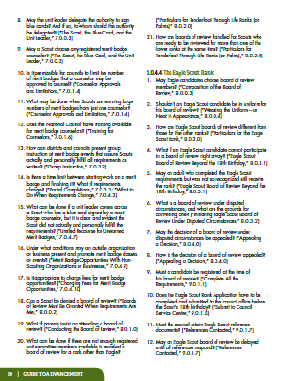
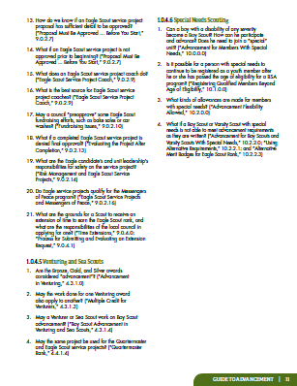
Section 1 Introduction
1.0.4.0 Frequently Asked Questions
Listed below are questions often asked of the National Advancement Program Team. Each question is followed by the location of the answer; that is, the heading and topic number under which the answer can be found in this Guide to Advancement.

Slide 18
Section 2 Advancement Defined
Advancement is the process by which youth members of the Boy Scouts of America progress from rank to rank.
2.0.0.1 It Is a Method—Not an End in Itself
2.0.0.2 Advancement Is Based on
Experiential Learning
2.0.0.3 Personal Growth Is the Primary Goal
2.0.0.4 The Methods of Scouting

Slide 19
Section 2 Advancement Defined
The Methods of Scouting
Ideals
Patrol method
Advancement
Association with adults
Outdoors
Leadership development
Uniform
Personal growth

Slide 20
Section 2 Advancement Defined
Throughout the Scouting program, we provide a place where the sense of belonging is an outcome of practicing skills, exploring interests, learning values, forming friendships, and enjoying adventure.
Advancement is the method by which we promote and
encourage the ongoing involvement and commitment that keeps members coming back for more. It works best when it is built into a unit’s program so that simply participating leads to meaningful achievement and recognition—and to a continually improving readiness for more complex experiences.

Slide 21
Guidelines for Recognition and
Advancement Committees
Section 3
Council and district advancement committees are responsible for implementing and facilitating advancement and processing most special awards and recognitions.
3.0.0.1 Council Advancement Committee Responsibilities
3.0.0.2 District Advancement Committee Responsibilities
3.0.0.3 Unit Advancement Responsibilities
3.0.0.4 Awards and Recognitions
3.0.0.5 Building an Advancement Committee
3.0.0.6 Orientation and Education Opportunities for Advancement Administrators
www.scouting.org/advancement

Slide 22
The Mechanics of Advancement
Section 4
4.0.0.1 Changes to Requirements
4.0.0.2 Reporting Advancement
4.0.0.3 Age Exception for Youth With Special Needs
4.1.0.0 Mechanics of Advancement:
In Cub Scouting
4.2.0.0 Mechanics of Advancement:
In Scouts BSA
4.3.0.0 Mechanics of Advancement:
In Venturing
4.4.0.0 Mechanics of Advancement:
In Sea Scouts

Slide 23
Special Considerations
Section 5
5.0.1.0 Advancement in Camp Settings
5.0.2.0 Extended Absence From Scouting
5.0.3.0 Lone Scouting
5.0.4.0 Youth From Other Countries
5.0.5.0 Religious Principles
5.0.6.0 Bestowing Posthumous Awards
5.0.7.0 Spirit of the Eagle Award
5.0.8.0 Using Technology-Based Tools in Advancement

Slide 24
Electronic
Advancement
Reporting
Section 6
6.0.0.1 Importance and Benefits of Electronic Advancement Reporting
6.0.0.2 About Internet Advancement
6.0.0.3 The Next Generation in Electronic
          Advancement Reporting
6.0.0.4 Internet Advancement Miscellany

Slide 25
The Merit Badge Program
Section 7
7.0.0.1 The Benefits of Merit Badges
7.0.0.2 About the Application for Merit Badge - Blue Card
7.0.0.3 The Scout, the Blue Card, and the Unit Leader
7.0.1.0 About Merit Badge Counselors
7.0.2.0 Merit Badge Counselor Lists
7.0.3.0 The Process of Counseling
7.0.4.0 Merit Badge Miscellany

Slide 26
Boards of Review:
An Overview for All Ranks
Section 8
8.0.0.1 Purpose and Timeliness of Boards of Review
8.0.0.2 Boards of Review Must Be Granted
When Requirements Are Met
8.0.0.3 Composition of the Board of Review
8.0.0.4 Wearing the Uniform — or Neat in Appearance
8.0.1.0 Conducting the Board of Review
8.0.2.0 Particulars for Tenderfoot Through Life Ranks (or Palms)
8.0.3.0 Particulars for the Eagle Scout Rank
8.0.4.0 Appealing a Decision (Star, Life, Eagle)

Slide 27
Boards of Review:
An Overview for All Ranks
Section 8
8.0.5.0 Venturing Boards of Review
8.0.6.0 Particulars for the Pathfinder and Discovery Awards
8.0.7.0 Particulars for the Summit Award

Slide 28
The Eagle Scout Rank
Section 9
9.0.1.0 The Eagle Scout Rank Application Process
9.0.2.0 The Eagle Scout Service Project
9.0.3.0 About Eagle Palms
9.0.4.0 Time Extensions

Slide 29
Advancement for Members With Special Needs
Section 10
10.1.0.0 Registering Qualified Members
Beyond Age of Eligibility
10.2.0.0 Advancement Flexibility Allowed
10.2.1.0 Advancement for Cub Scouts With Special Needs
10.2.2.0 Advancement in Scouts BSA for Scouts With Special Needs
10.2.3.0 Advancement for Venturers and
Sea Scouts With Special Needs

Slide 30
Appendix
Section 11
11.1.0.0 Reporting Merit Badge Counseling Concerns
11.2.0.0 Request for Extension of Time to
Earn Eagle Scout Rank
11.3.0.0 Belated Eagle Scout Rank Application
11.4.0.0 Request for Registration Beyond the Age of Eligibility
11.5.0.0 Individual Scout Advancement Plan

Slide 31
Questions and Answers
Wait! Let’s go back to the beginning…
1.0.1.0 How to Approach Issues Not Covered in the Guide to Advancement
Be aware that statements or interpretations offered from unofficial websites and other such sources may be out of date or incorrect. They will not be considered in resolving advancement questions and issues. In situations not specifically covered in this guide, advancement chairs, coordinators, or other administrators should make decisions based on the aims and mission of the Boy Scouts of America, as well as the Scout Oath and Scout Law, other applicable official and current BSA resources — and common sense.

Slide 32
Questions and Answers

